Slide 1
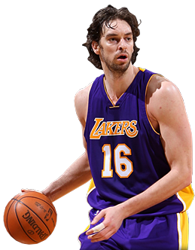
Pau Gasol
Martin Výboh, 8.B

Slide 2
Content
Introduction
Playing in Clubs
Playing in National Team
Statistics and Awards
Gallery

Slide 3
Introduction
Pau Gasol is a Spanish professional basketball player
He was born on July 6, 1980 in Barcelona
He is 213cm long
He weighs 113kg
In basketball, he plays power forward or center
He has a younger brother, Marc, which plays basketball, too

Slide 4
Playing in Clubs
He started to play in Spanish league (ACB) for FC Barcelona Regal
He was drafted to NBA in 2001 from the third place by Atlanta Hawks but his rights were traded to Memphis Grizzlies
He played in Memphis from 2001 to 2008
In 2008 he was traded to LA Lakers where he is up to now

Slide 5
Playing in National Clubs
He plays in Spanish national clubs several times
He won FIBA EuroBasket 2 times
He won FIBA WorldCup 1 times
He came second two times on Olympic Games (Beijing, London)

Slide 6
Statistics and Awards
In NBA he scored in average 18,4 points per game
He played 845 games in NBA
He won NBA two times
He was in NBA All-Star Game 4 times
He was two times Player of the Year in Europe

Slide 7
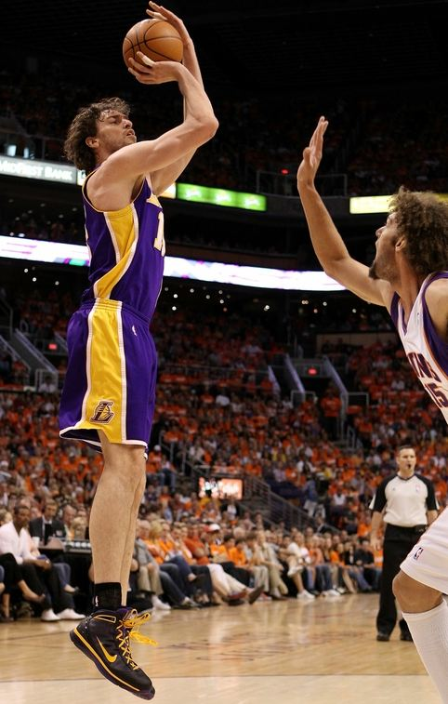
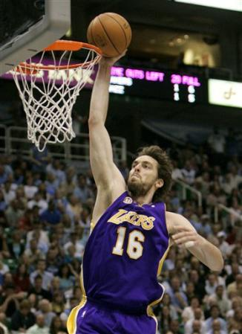
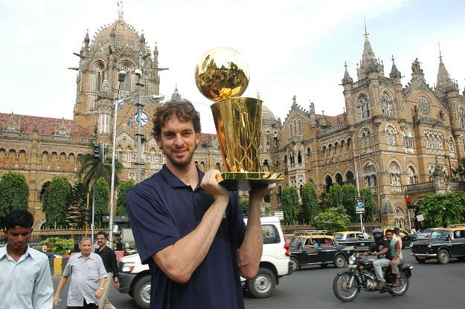
Gallery

Slide 8
Statistics and Awards
In NBA he scored in average 18,4 points per game
He played 845 games in NBA
He won NBA two times
He was in NBA All-Star Game 4 times
He was two times Player of the Year in Europe

Slide 9
Thanks for attention!

